Slide 1

RNN

Slide 2
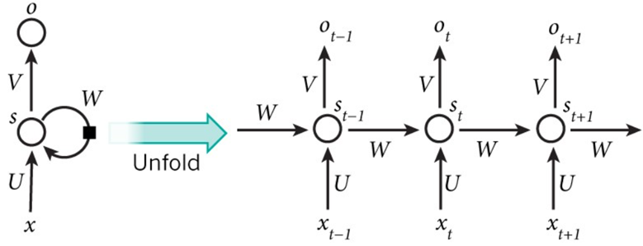


RNN ( Recurrent Neural Network )
RNN = Models that receive sequential or time series data to learn the entire content
Sequential data : (ex) Language
Time Series data : (ex) stock prices
It is impossible to remember on a network before RNN.
RNNs are connected to edges with directions to form a mild structure.
RNN stores sequence information of previously entered data in a hidden state and outputs the resulting value considering the previous sequence information when new data is entered.
X(t) = Input data at a specific time t
S(t) = A hidden layer of time t has a value of S(t-1)
S(t) =
O(t) =

Slide 3
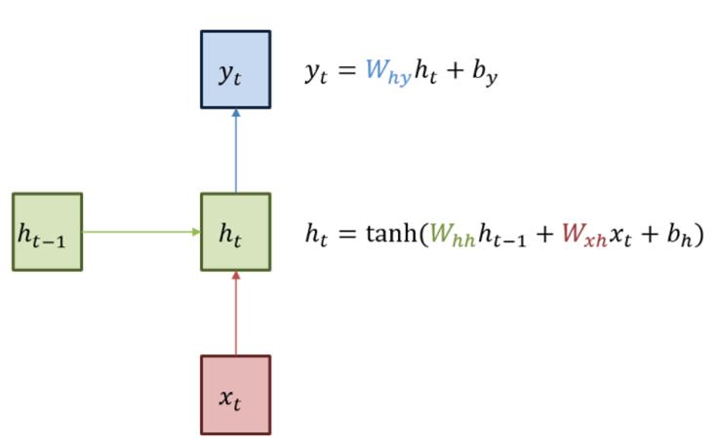
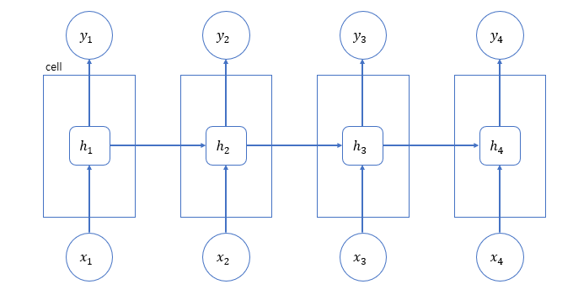
RNN – Structure
< calculation >
The expression consists of the weights Wxh for converting inputs into outputs and the weights Whh and bias by for converting outputs from RNNs into outputs for time t.
< Simple Structure >

Slide 4
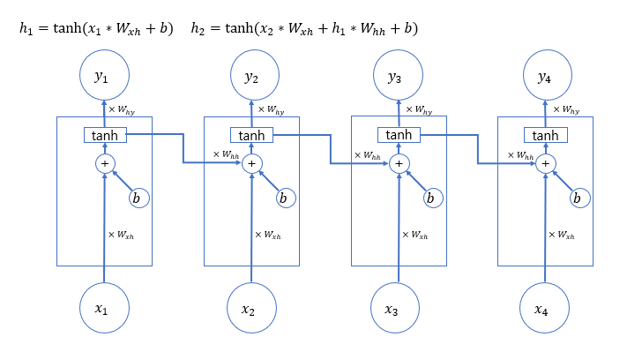
RNN – Structure
*
The entered x1 is multiplied by the weight Wxh for it and added to the subsequent deviation by
Subsequently, the result obtained by applying the activation function tanh is passed to the next layer by multiplying the weight Whh for converting the result into an output for time t
The next layer continues to repeat this process

Slide 5
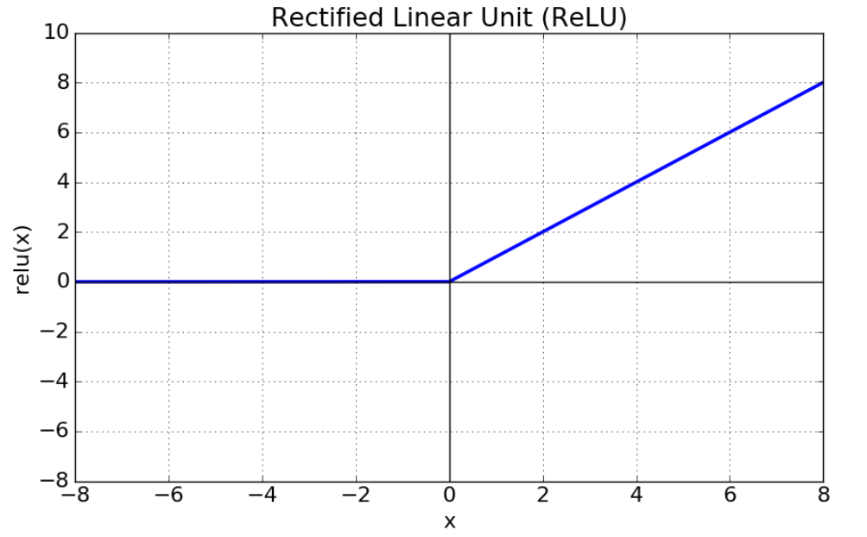

RNN – Activation function ( relu )
In a deep learning network, the values entered into a node pass through a nonlinear function and pass it to the next layer, which is called an activation function
We use nonlinear functions rather than linear functions because we can take deep layer layers of deep learning models
The activation function in an artificial neural network is crucial because it is the role of determining how to output input data to the next layer

Slide 6
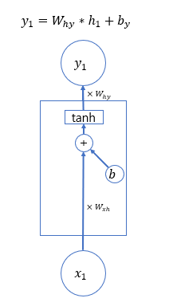
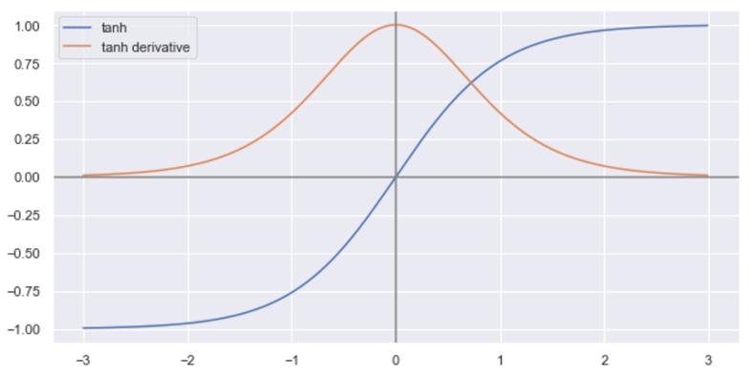
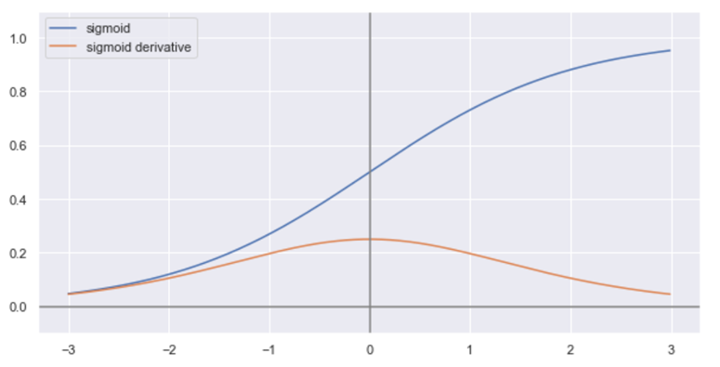
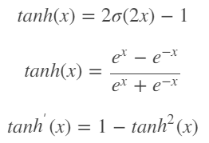

RNN – Activation function (sigmoid, tanh)
*
In one RNN model, the weights and activation functions do not change
The activation function f is primarily used as tanh

Slide 7
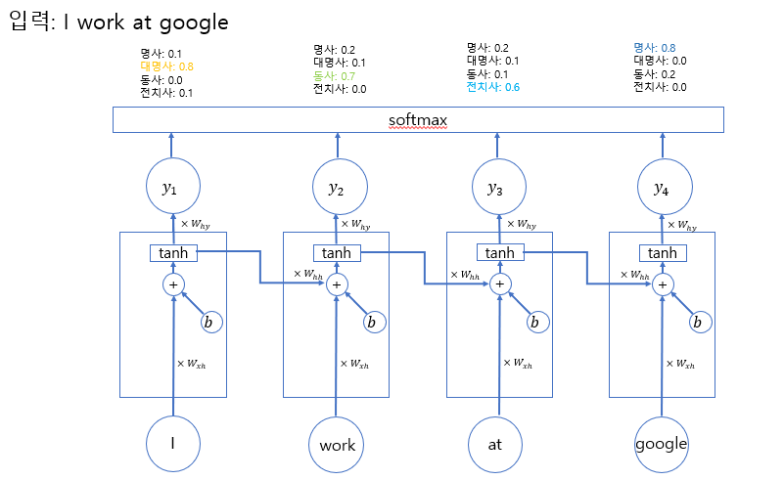
RNN – Softmax
< Softmax layer >
= A function that normalizes the output value in the last step for classification of the class for the output value of a neuron
=Use a function called softmax for the output value if you need to select from a variety of categories
When you use a softmax function, it generates a probability score when there are N numbers
(Probability score: 1.0, each of which is above zero or higher)
In the hidden state, the weights are multiplied and the highest probability is chosen.

Slide 8
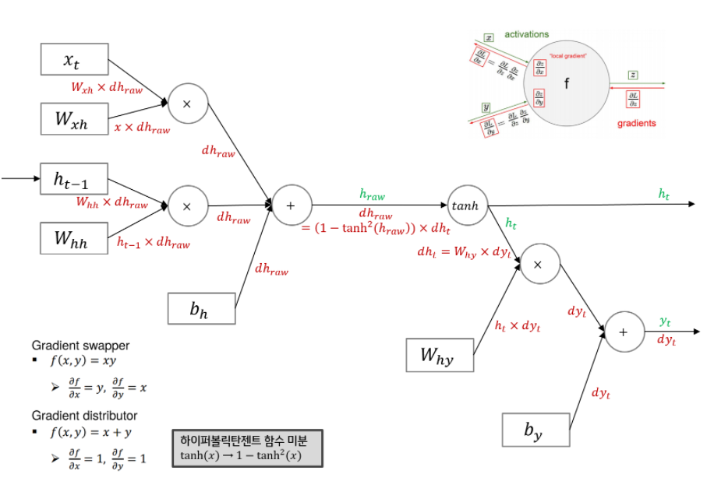
RNN – Back propagation
*
< Bach propagation >
= One of the common algorithms for learning artificial neural networks is to multiply the local derivatives of the function in reverse directions
The gradient of yt for the final loss is expressed in dyt, which is calculated in the opposite direction

Slide 9
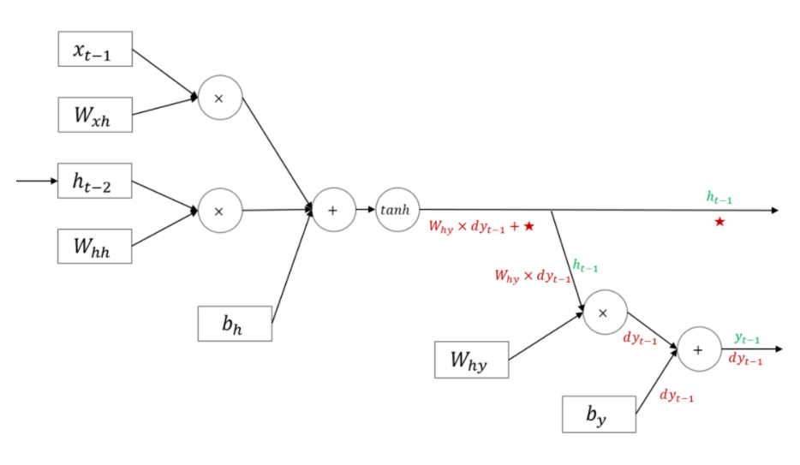
RNN – Back propagation
However, you need to pay attention to the picture below. RNN is a neural network in which hidden nodes have a circular structure. That is, ht-1 is reflected when ht is created. In other words, dht-1 in the figure below means that not only the gradient that flowed from Loss at t-1 but also the gradient that corresponds to ★ is added and reflected simultaneously.

Slide 10
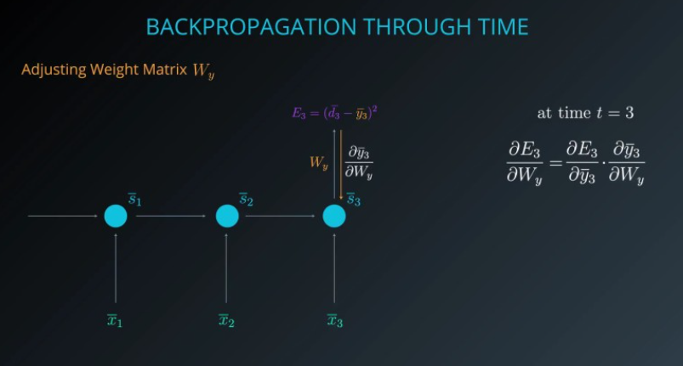
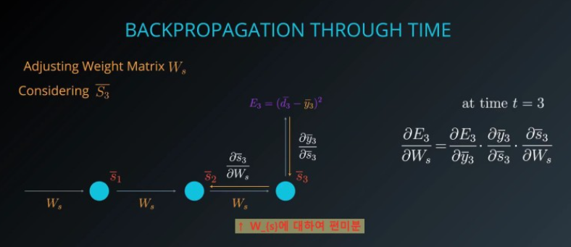
RNN – Back propagation

Slide 11
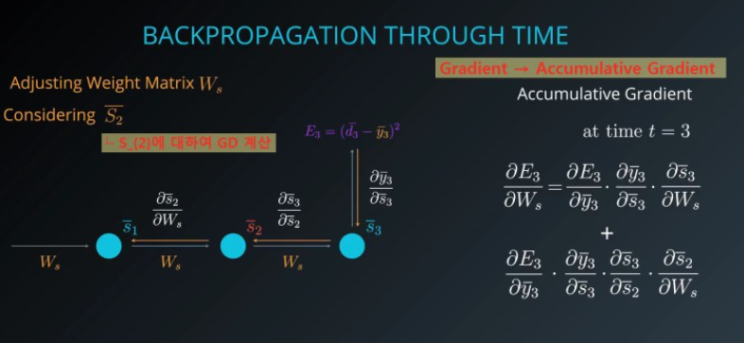
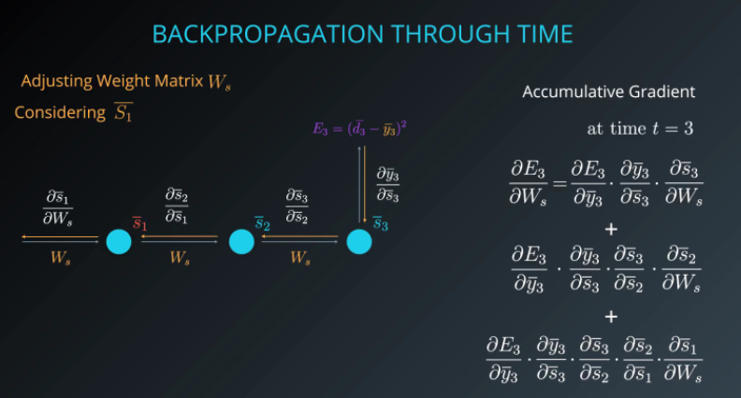
RNN – Back propagation

Slide 12
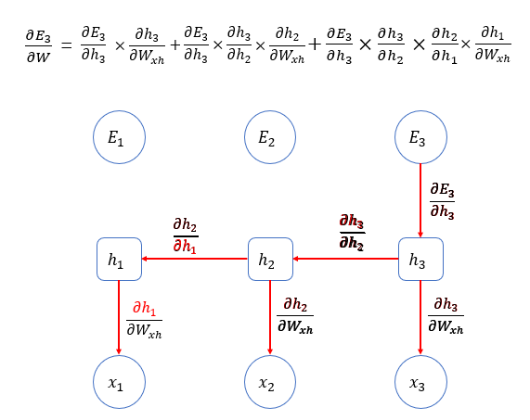
RNN – Back propagation
Calculate the backpropagation by dividing each weight by the hidden state.

Slide 13
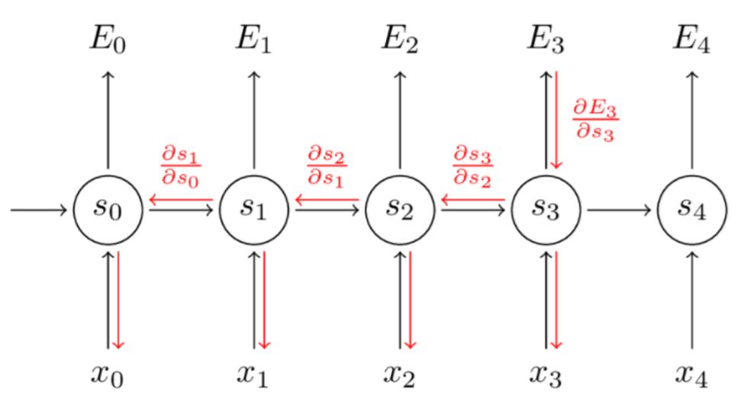
RNN – Back propagation
This update allows the error of the current time to be reversed to the state of the past time. If this is represented in a picture, it is the same as on the right.

Slide 14
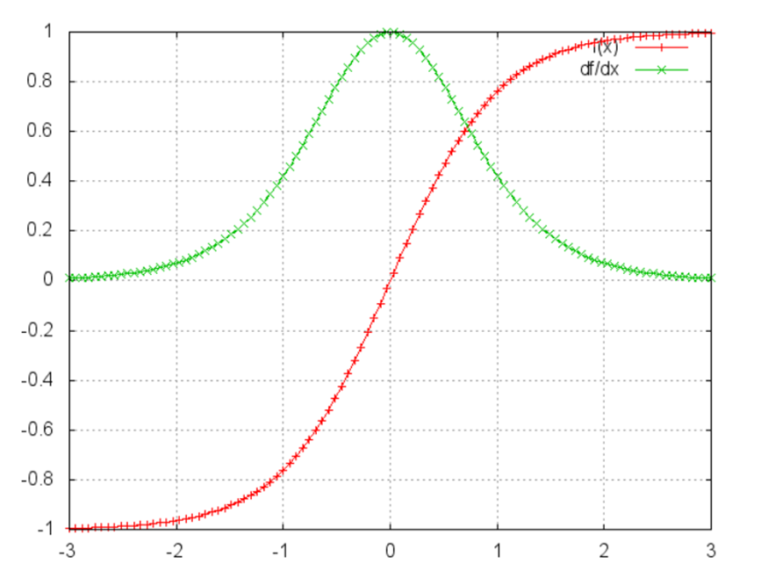
RNN – problem
< vanishing Gradient >
= Based on previous data, RNN proceeds with learning when new data comes in. However, as you go back to the past, the gradient calculation is made up of multiplication operations, so the calculation does not work properly
according to the figure, if you multiply the values greater than 1, it will dissipate, and if you multiply the values less than 1, it will converge to zero and disappear
In other words, long-term memory, which can be remembered recently, but not the old, becomes a bad model. It's the LSTM that secures this.

Slide 15
This is the end of the presentation on RNN!
There will be an explanation of the LSTM afterwards.

